Slide 1




Azure Cloud
Functions, DevOps & Monitoring
Powered by

Slide 2



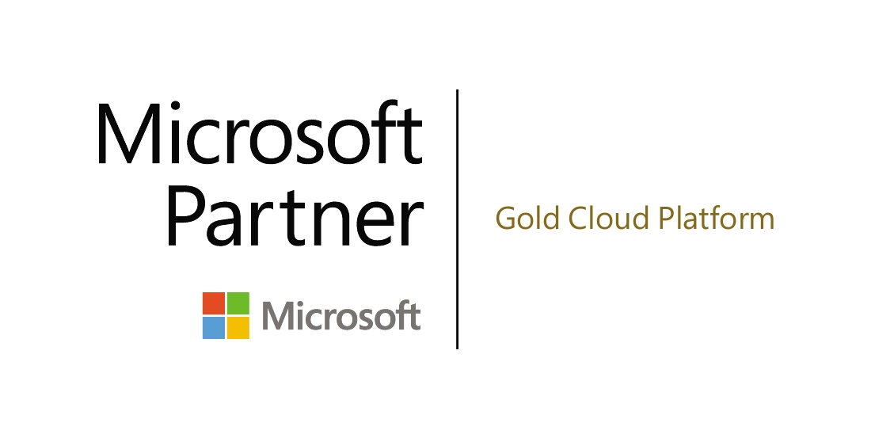

Spezialisiert auf Cloud-Computing, Software-Engineering und Data Analytics / BI -Technologien
Ganzheitliches Angebot als Cloud Solution Provider - von der Entwicklung bis zum Betrieb von Cloud-Lösungen
Gegründet 2012 mit Sitz in Rosenheim, derzeit 17 Mitarbeiter
Erfahrung aus mehr als 15 Jahren Softwareentwicklung
Technologie-Fokus: Microsoft Azure Cloud, .NET C#, .NET CORE, REST, Angular, ASP.NET
Konzeption, Implementierung und Betrieb von SaaS-, Web-, Mobile- und IoT-Anwendungen
technologie
kompetenz
Entwicklung, Beratung und Coaching rund um Cloud-Computing
teamwork

Slide 3








Agenda
Azure Monitoring
Wir beantworten die Frage wieso Monitoring wichtig ist und geben eine Übersicht über die Monitoring Services von Azure
Hand ON
Azure Functions
Azure Functions
Betrachtung von Grundlagen und best practices zu Azure Functions sowie Web API und zugehörige Services
Hand ON
Application Insights und Monitoring Services

Slide 4

Basics

Slide 5
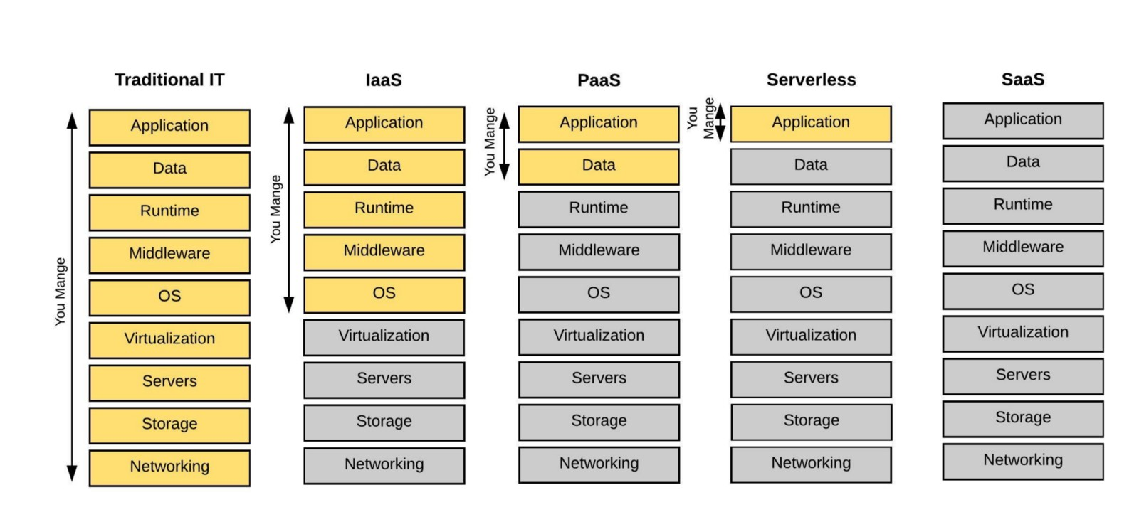

Slide 6
What is the right size of
servers for my business needs?
How do I deploy new code to my server?
What media should I
use to keep backup?
What happens in case of
server hardware failure?
Which packages should be on my server?
What size of servers
should I buy?
Who monitors
my App?
How often should I backup my server?
How can I scale my app?
How can I increase server utilization?
Who has physical
access to my servers?
Which OS should I use?
Do I need secondary network connection?
Are my server in a
secure location?
What happens if the
power goes out?
Who monitors
my Servers?
Do I need a UPS?
What storage I need to use?
How many servers
do I need?
How can I dynamically configure my app?
It takes how long to provision a new server?
How often should
I patch my servers?
On-Premises
The “evolution” of application platforms
Notes:
All good things begin with a story.
So before I talk to you about serverless, I wanted to discuss some history of how apps have been built through the years and how that has led us to the computing options we have today.
Buy your own hardware and software
Run it in your own data-centers
Deal with a multitude of questions
# of servers
Physical security
Hardware failure
Software patching
Backup
Essentially a lot of questions, not all of which might be directly related to running your business. For example, if you are running an insurance company, you want to spend your time growing and innovating in the insurance domain, not worrying about how to handle servers.

Slide 7
What is the right size of servers for my business needs?
How can I increase server utilization?
How many servers do I need?
How can I scale my app?
How often should I patch my servers?
How do I deploy new code to my server?
How often should I backup my server?
Which OS should I use?
Which packages should be on my server?
Who monitors my App?
On-Premises
IaaS
The “evolution” of application platforms
Notes:
Along came the cloud, and provided some relief from some of those questions.
IaaS in the cloud, allowed you to forget about managing all that physical hardware. Instead of hosting it yourself, you could now utilize servers hosted by someone else. While the worries around managing physical infrastructure are gone, there are a number of questions that still need to thought about:
How many virtual machines do I need?
How many would I need in future when my usage grows?
How to handle updating the servers for the latest security patches
How to think about deploying my code and the various dependencies, such as application runtimes, to the server
Who monitors my apps and so on
This means that you still haven’t reached that ideal state where you could focus purely on your business and its problems.

Slide 8
What is the right size of “servers” for my business needs?
How can I increase “server” utilization?
How many “servers” do I need?
How can I scale my app?
On-Premises
IaaS
PaaS
The “evolution” of application platforms
Notes:
Well, the cloud continue to help with that problem and with the advent of PaaS, there was even more simplification. PaaS allows you to just worry about your app, and let the cloud vendor take care of not only the physical hardware, but also the ongoing management of the operating environment like Operating Systems, Virtual Machines or Containers, as well as the various application runtimes, whether it is Java Runtime, .NET, Node.js, and so on.
You are not completely free from thinking about servers however, since you still have to worry about how to scale your app and accordingly specify the number and size of the various compute resources your apps would need at various times.

Slide 9

Azure Web Apps

Slide 10
PaaS Service der einfaches skalieren und load balancing ermöglicht
Möglichkeit zum erstellen von REST API`s, Mobile, sowie Linux oder Windows basierenden Web Apps
Leichte umsetzung von Continuous deployment und Nutzung mit multiple Language & Frameworks wie ASP.NET, Node.js, Java, PHP, Python

Slide 11
How do I architect my app?
Serverless, the platform for next gen apps
On-Premises
IaaS
PaaS
Serverless
The “evolution” of application platforms

Slide 12
Abstraktion von Servern
Manage app, not servers
Event driven / Skalierung
DevOps Optimierung
Micro-Billing
Schnelleres ausrollen

Slide 13

Azure Functions

Slide 14

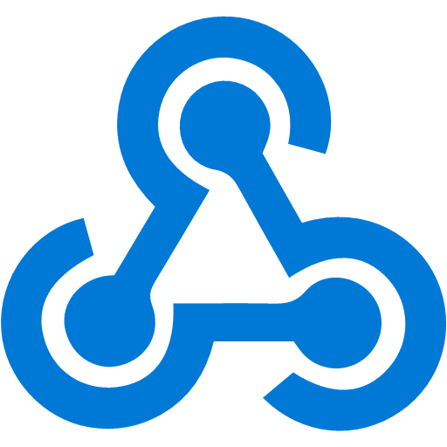







Azure Functions
Events
Code
Outputs
React to timers, HTTP, or events from your favorite Azure services, with more on the way
Author functions in C#, F#, Node.JS, Java, and more
Send results to an ever-growing collection of services

Slide 15
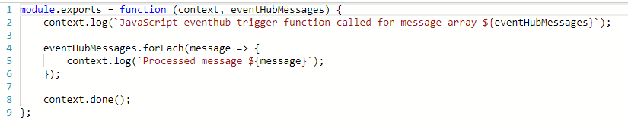
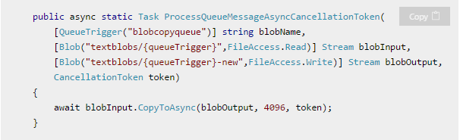
Wie schauen Functions aus?
Function als “unit of work”
Functions sind zustandslos und haben einen Start und ein Ende
Functions werden getriggert
Functions haben Inputs und outputs

Slide 16


Azure Hands On
Angular Frontend mit einfachem ImageUpload
ImageUpload in BlobStorage über ASP.NET Core Middleware
Azure Function
Trigger auf Änderungen im Blob Storage
Bearbeiten hochgeladener Bilder
Ablegen im „processed“ Container im Blob Storage
Web App File Upload
Storage / File Blob Container
ImageProcessor
https://github.com/whiteducksoftware/FH_Azure

Slide 17
Health
…
Usage & User Flow
Track outputs & Implementation
Cost optimization
Why Monitoring?
Error detection
Optimization
Application & Infrastrucure Monitoring
Planning
Information
Security
Notes:
Bis Hypervisor-Level übernimmt Provider
Unterschiedlich zu “traditionellem” Infrastructure Monitoring
Informationen sammeln und analysieren
Ziel: Optimale performance und Sicherheit

Slide 18
Azure Monitoring Overview

Slide 19
Infrastructure Monitoring Service
Network Watcher & Performance Monitor
Network Watcher
Ausführliche Netzwerküberwachung
z.B Topologie, IP Flow, Packetüberwachung, Security Groups
Flow Logs, Diagnostic Logs, Traffic Analytics
Erfasst Ein-/Ausgehende Paketdaten
IP Flow Verify → Prüft Paket Parameter Source/Dest/Port/Protokoll
Network Performance Monitor (OMS)
Überwacht Netzwerkleistung und Integrität / Diagnose
Performance Monitor → Verbindungen zwischen Deployments
Service Endpoint Monitor → Verbindung User-Service (Bottlenecks)
ExpressRoute Monitor → End2End z.B Office-Azure (Hybrid)
Marketplace (Management Solution)
Notes:
Diagnostic Logs: How the Ressource Operates z.B Get Secret from Key Vault
→Unterschied zu Activity Log
Flow Logs: Ingress and Egress (Network)

Slide 20
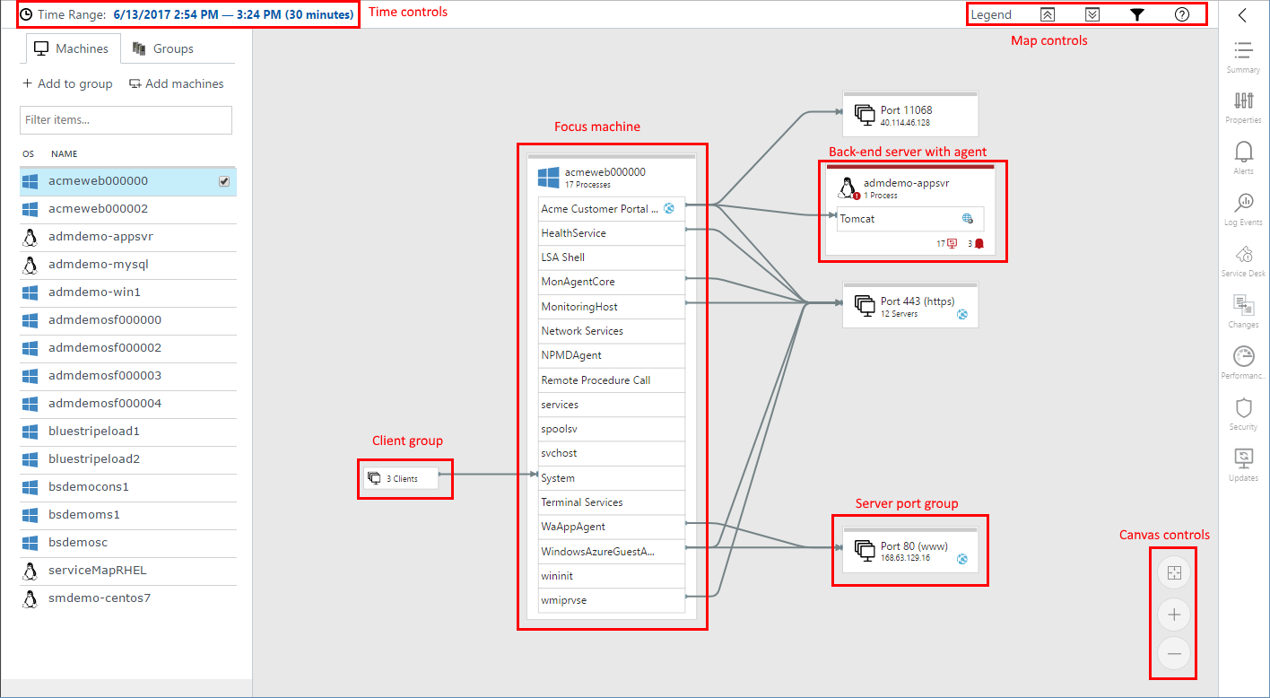
Infrastructure Monitoring Service
Service Map
Visualisierung von Komponentenkommunikation (Windows, Linux)
Discovery → Dependencies, Failed/Suprised Connections..
Incident Management → Miskonfigurationen, Verbindungswege..
Marketplace (Management Solution)
Notes:
Diagnostic Logs: How the Ressource Operates z.B Get Secret from Key Vault →Unterschied zu Activity Log
Flow Logs: Ingress and Egress (Network)

Slide 21
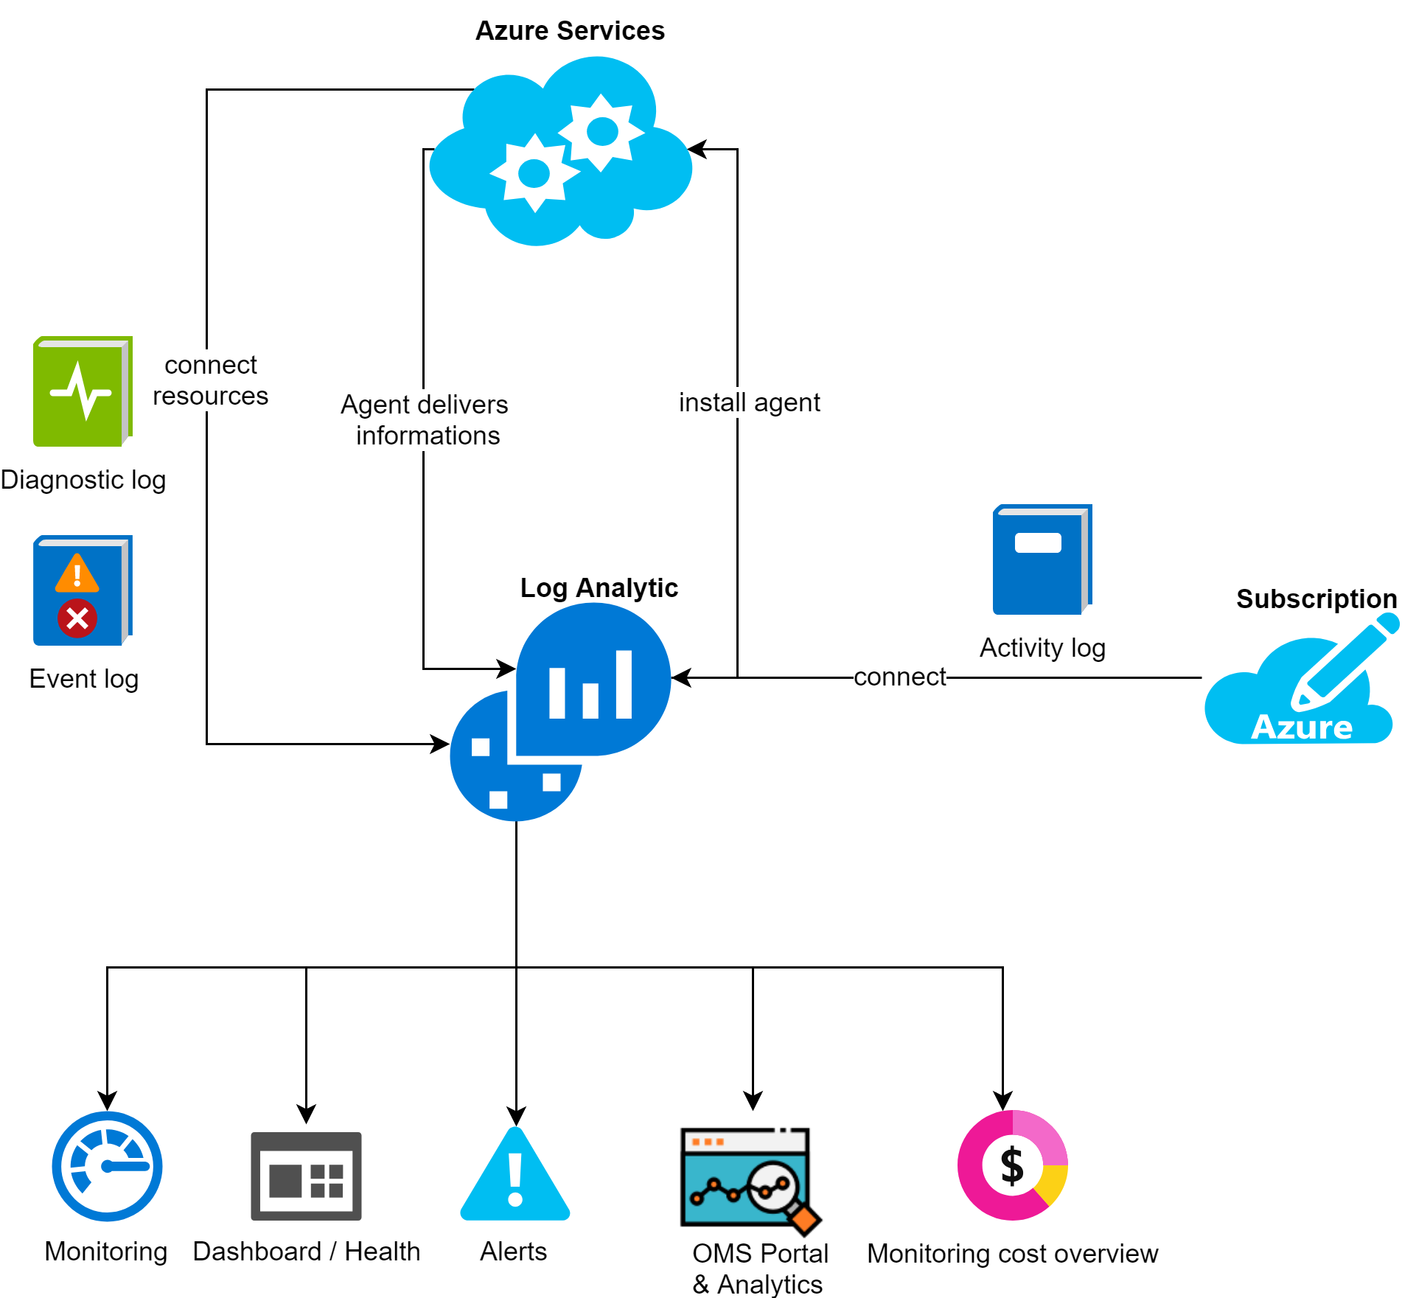
Azure Log Analytic

Slide 22
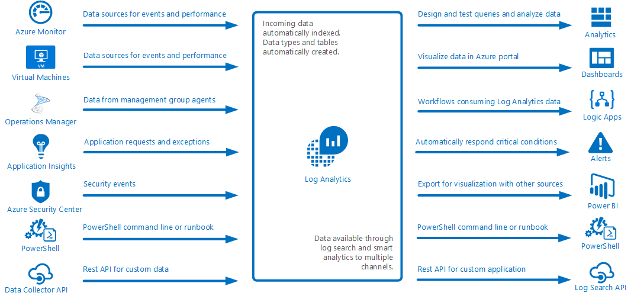
Log Analytic & Operation Management Suite (OMS)
Logauswertung vieler Service
Kusto Query Language
Sammelt Daten in zentralem Repository
Events, Performance Data, Custom Data
Durch API bereitgestellt
Azure Dienste, HW und VM
Collection und Action separiert
Alerts (Email, Runbook, Webhook)
Benutzerdefinierte Views / Dashboard
„Nicht Echtzeit“

Slide 23
Azure Monitor & Service Health
Service Health
Azure Status: Prüft Integrität von Azure Diensten
Ressource Health: Prüft Integrität von Ressourcen
Service Health: Personalisierte Ansicht von Azure Diensten
Azure Monitor
Liefert Infrastrukturmetriken und Protokolle von Azure Diensten
Bietet übersichtliche Auflistung
Notes:
Monitor
Kostenübersicht
Übersicht über ganze Subscription
Aktivitäts- und Diagnoseprotokolle
Schnellste Metrikpipeline
Daten von 30 Service → Wird ausgebaut
Alerting →Eher als Informationsfilter

Slide 24
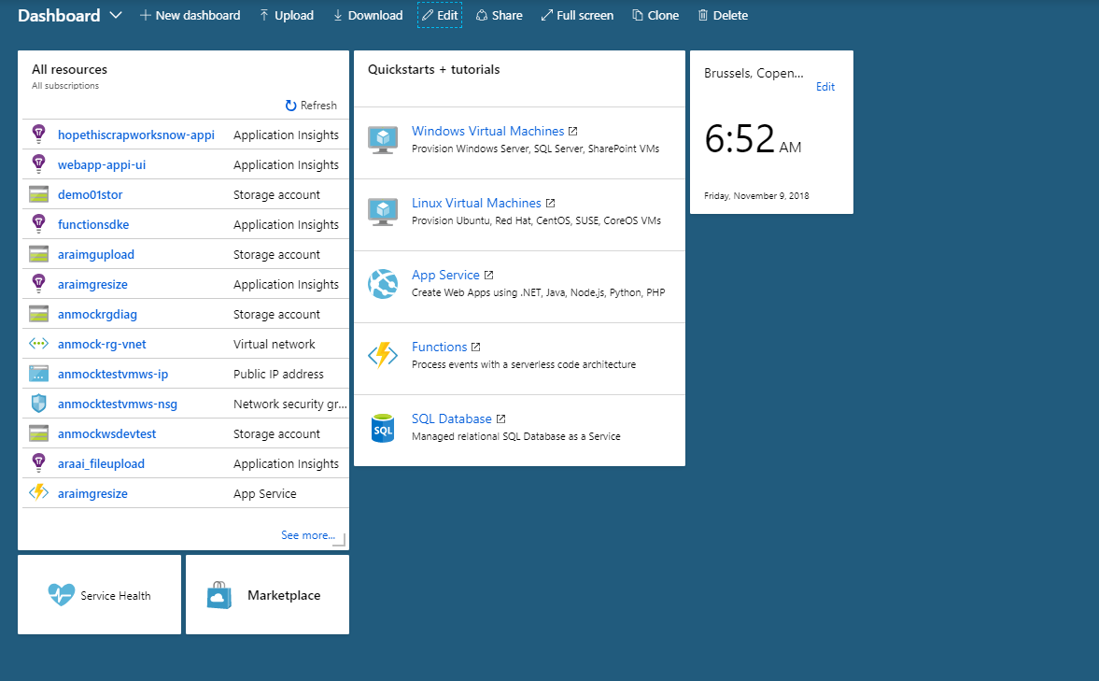
Portal Demo Kusto: https://portal.loganalytics.io/demo#/discover/home
Portal Demo: Monitoring Integration in Azure
(z.B auf RG Level)
Portal Demo:
Azure Monitor Cost Monitor
Create and Connect Services
Marketplace Solutions
Notes:
Log Analytic Workspace erstellen → VM → VM connecten
Solutions herzeigen
Activity Log → Subscription connecten

Slide 25

Application Insights

Slide 26

Application Insights
Application Insights
Anwendungsmonitoring
Request Rates, Response Times, Failure Rates, Exceptions, Dependency Rates, Page Views, Performance, AJAX Calls, User/Session Counts, Host Diagnostics (Docker), Trace Logs
Benutzerdefinierte Metriken und Events
Innerhalb VS und im Azure Portal nutzbar
Any App & Any Plattform (.NET, .NET Core, Java, NodeJS, Javascript, ...)
„Live“ Metrics Stream
1s Latenz → (ca. 10s with Ingest)
Ab SDK 2.2.0
Alerting Möglichkeit
Nutzungsauswertung

Slide 27
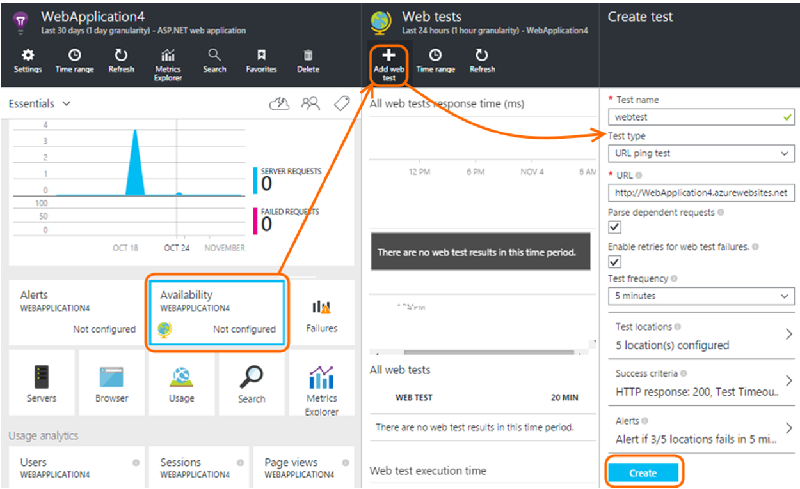
Application Insights
Application Insights
Ping & Web Tests
Optimierung mittels „Sampling“
Bei vielen Telemetriedaten z.B nur 1/5 Datensätze behalten = 20%
Hilft monatliches Kontingent einzuhalten
Adaptive (Automatisch)
Fixed Rate (User)
Ingestion (User)
Free Tier
90d Aufbewahrung
5GB Daten
Notes:
Sampling:
Automatisch durchgeführt aber manuell konfigurierbar
Arten:
Adaptiv (Default) → sendet direkt von App weniger
Fixed Rate(Nutzergesteuert) → Sendet direkt von App weniger
Ingestion → Reduziert Daten die gesendet wurden ab eintreffen im Portal

Slide 28
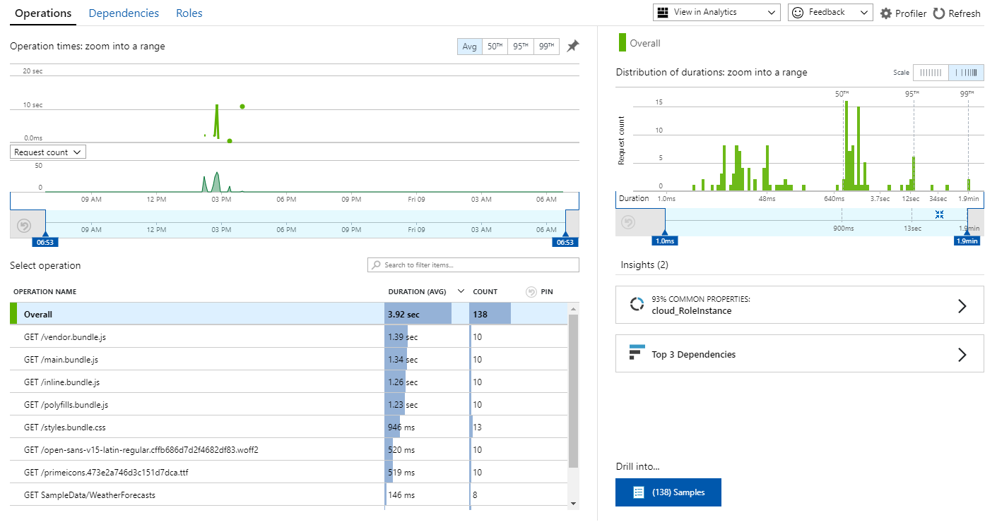
Portal Demo: Application Insights Overview

Slide 29

Zu beachten!
Application Insights
Planung und Preiskalkulation
Managed Solutions /Marketplace = Viele Möglichkeiten
Updates & Dokumentation
Regionale Verfügbarkeit
Überschneidungen
Service Status beachten (z.B Preview)
SLA beachten
Indexing Log Data in OMS kann bis zu 6h dauern
Near Real Time Alerts verwenden
Datenschutz beachten (z.B Welche Daten erfasst AppInsights)
Monitoring erfordert genaue Anforderungen

Slide 30
Azure Hands On
Erstellen und verbinden von Application Insights mit Azure Function und Image Upload Komponenten
Einbauen von Custom Events und Monitoring Services in Middleware und Front End
Web App File Upload
Application Insights (Web/UI/Function)
Storage / File BlobContainer
ImageProcessor
https://github.com/whiteducksoftware/FH_Azure

